Slide 1
Computer graphics III –
Monte Carlo integration II
Jaroslav Křivánek, MFF UK
Jaroslav.Krivanek@mff.cuni.cz

Slide 2
Monte Carlo integration
General tool for estimating definite integrals
Integral:
f(x)
Monte Carlo estimate I:
p(x)
0
ξ₅
ξ₃
ξ₁
ξ₄
ξ₂
ξ₆
1
Works “on average”:

Slide 3
Generating samples from a distribution

Slide 4
Generating samples from a 1D discrete random variable
Given a probability mass function p(i), and the corresponding cdf P(i)
Procedure
  Generate u from Uniform(0,1)
  Choose x_{i} for which
  (we define P(0) = 0)
The search is usually implemented by interval bisection
CDF

Slide 5
Generating samples from a 2D discrete random variable
  Given a probability mass function p_{I,J}(i, j)
Option 1:
  Interpret the 2D PMF as a 1D vector of probabilities
  Generate samples as in the 1D case

Slide 6
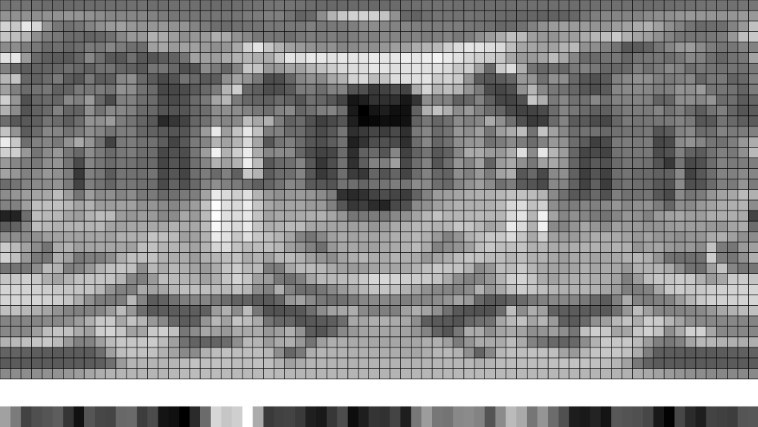
Generating samples from a 2D discrete random variable

Slide 7
Generating samples from a 2D discrete random variable
Option 2 (better)
  “Column” i_{sel} is sampled from the marginal distribution, given by a 1D marginal pmf
  “Row” j_{sel} is sampled from the conditional distribution corresponding to the “column” i_{sel}

Slide 8
Generating samples from a 1D continuous random variable
Option 1: Transformation method
Option 2: Rejection sampling
Option 3: Metropolis-Hastings sampling
  Separate lecture

Slide 9
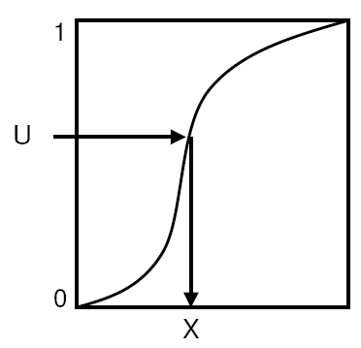
Transformation method
Consider the random variable U from the uniform distribution Uniform(0,1). Then the random variable X
has the distribution given by the cdf P.
To generate samples
according to a given pdf p,
we need to:
  calculate the cdf P(x) from the pdf p(x)
  calculate the inverse cdf P⁻¹(u)

Slide 10
EXAMPLE DERIVATION FOR SAMPLING FROM UNIFORM(a,b) and EXP(a,b)

Slide 11
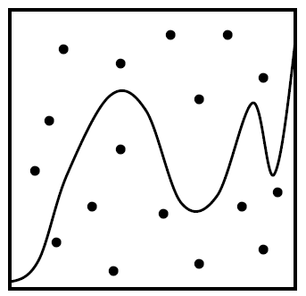
Rejection sampling in 1D
MAX
Algorithm
  Choose random u₁ from Uniform(a, b)
  Choose random u₂ from Uniform(0, MAX)
  Accept the sample if p(u₁) > u₂
    Return u₁ as the generated random number
  Repeat until a sample is accepted
The accepted samples have the
distribution given by the pdf p(x)
Efficiency = % of accepted samples
  Area under the pdf graph / area of the bounding rectangle
p(x)
0
a
b

Slide 12
Transformation method vs. Rejection sampling
  Transformation method: Pros
    Almost always more efficient than rejection sampling (unless the transformation formula x = P⁻¹(u) turns out extremely complex)
    Constant time complexity. The number of random generator invocations is known upfront.
  Transformation method: Cons
    May not be feasible (we may not be able to find the suitable form for x = P⁻¹(u)), but rejection sampling is always applicable as long as we can evaluate and bound the pdf (i.e. rejection sampling is more general)
  Smart rejection sampling can be very efficient (e.g. the Ziggurat method, see Wikipedia, https://en.wikipedia.org/wiki/Ziggurat_algorithm)

Slide 13
Sampling from a 2D continuous random variable
Conceptually similar to the 2D discrete case
Procedure
  Given the joint density p_{X,Y}(x, y) = p_{X}(x) p_{Y|X}(y | x)
  Choose x_{sel} from the marginal pdf
  Choose y_{sel} from the conditional pdf

Slide 14
EXAMPLE 2D Euclidean derivation DERIVATION
()

Slide 15
EXAMPLE derivation
On the (hemi)sphere

Slide 16
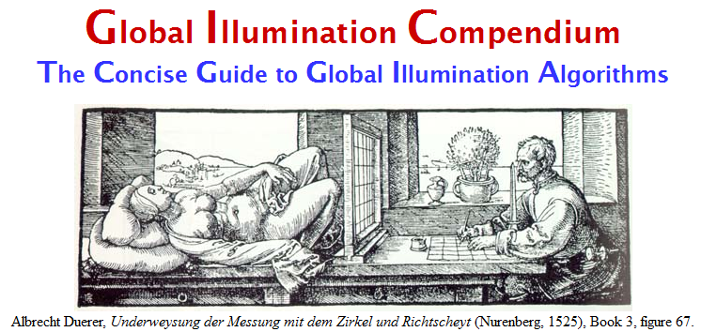
Transformation formulas for common cases in light transport
P. Dutré: Global Illumination Compendium, http://people.cs.kuleuven.be/~philip.dutre/GI/
PBRT, Section XXXX

Slide 17
Importance sampling from the physically-plausible Phong BRDF
Ray hits a surface with a Phong BRDF. How do we generate a ray direction proportional to the BRDF lobe?
Procedure
  Choose the BRDF component (diffuse reflection, specular reflection, possibly refraction)
  Sample direction from the selected component
  Evaluate the total PDF and BRDF

Slide 18
Physically-plausible Phong BRDF
Where
Energy conservation:

Slide 19
Selection of the BRDF component
  pd = max(rhoD.r, rhoD.g, rhoD.b);
  ps = max(rhoS.r, rhoS.g, rhoS.b);
  pd /= (pd + ps); // prob of choosing the diffuse component
  ps /= (pd + ps); // prob of choosing the specular comp.
  if (rand(0,1) <= pd)
    genDir = sampleDiffuse();
  else
    genDir = sampleSpecular(incDir);
  pdf = evalPdf(incDir, genDir, pd, ps);

Slide 20
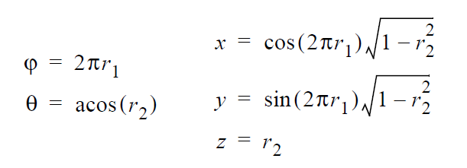
Sampling of the diffuse lobe
Importance sampling with the density p(θ) = cos(θ) / π
  θ …angle between the surface normal and the generated ray
  Generating the direction:
    r1, r2 … uniform random variates on <0,1)
Reference: Dutre, Global illumination Compendium
Derivation: Pharr & Humphreys, PBRT
Where derived? (specific reference)

Slide 21
sampleDiffuse()
// generate spherical coordinates of the direction
const float r1 = rand(0,1), r2 = rand(0,1);
const float sinTheta = sqrt(1 – r2);
const float cosTheta = sqrt(r2);
const float phi = 2.0*PI*r1;
// convert [theta, phi] to Cartesian coordinates
Vec3 dir (cos(phi)*sinTheta, sin(phi)*sinTheta, cosTheta);
return dir;

Slide 22
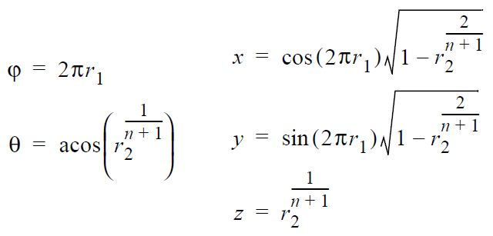
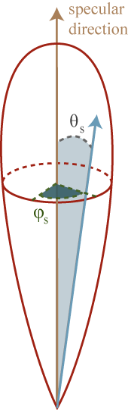
Sampling of the glossy (specular) reflection
Importance sampling with the pdf p(θ) = (n+1)/(2π) cos^{n}(θ)
  θ …angle between the ideal mirror reflection of ω_{o} and the generated ray
  Formulas for generating the direction:
    r1, r2 … uniform random variates on <0,1)

Slide 23
sampleSpecular()
// build a local coordinate frame with ideal reflected direction = z-axis
Frame lobeFrame;
lobeFrame.setFromZ( reflectedDir(incDir) );
// generate direction in the lobe coordinate frame
// use formulas form prev. slide, n=phong exp.
const Vec3 dirInLobeFrame = rndHemiCosN(n);
// transform dirInLobeFrame to surface frame
const Vec3 dir = lobeFrame.toGlobal(dirInLobeFrame);
return dir;

Slide 24
evalPdf(incDir, genDir, pd, ps)
return
pd * getDiffusePdf(genDir) +
ps * getSpecularPdf(incDir, genDir);
formulas from prev. slides

Slide 25
Variance reduction methods for MC estimators

Slide 26
Variance reduction methods
Importance sampling
  The most commonly used method in light transport (most often we use BRDF-proportional importance sampling)
Control variates
Improved sample distribution
  Stratification
  quasi-Monte Carlo (QMC)

Slide 27
Importance sampling
f(x)
p(x)
0
X₅
X₃
X₁
X₄
X₂
X₆
1

Slide 28
Importance sampling
Parts of the integration domain with high value of the integrand f are more important
  Samples from these areas have higher impact on the result
Importance sampling places samples preferentially to these areas
  I.e. the pdf p is “similar” to the integrand f
Decreases variance while keeping unbiasedness

Slide 29
Control variates
f(x)
g(x)
0
f(x)-g(x)
0
1

Slide 30
Control variates
Consider a function g(x), that approximates the
integrand and we can integrate it analytically:
Numerical integration (MC)
Hopefully with less variance
than integrating f(x) directly.
We can integrate
analytically

Slide 31
Control variates vs. Importance sampling
Importance sampling
  Advantageous whenever the function, according to which we can generate samples, appears in the integrand as a multiplicative factor (e.g. BRDF in the reflection equation).
Control variates
  Better if the function that we can integrate analytically appears in the integrand as an additive term.
This is why in light transport, we almost always use importance sampling and almost never control variates.

Slide 32
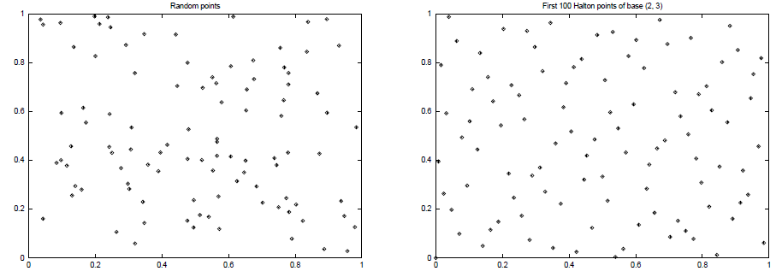
Better sample distribution
Generating independent samples often leads to clustering of samples
  Results in high estimator variance
Better sample distribution => better
coverage of the integration domain
by samples => lower variance
Approaches
  Stratified sampling
  quasi-Monte Carlo (QMC)

Slide 33
Stratified sampling
Sampling domain subdivided into disjoint areas that are sampled independently
f(x)
f(x_{i})
0
x₁
x₂
x₃
x₄
1

Slide 34
Stratified sampling
Subdivision of the sampling domain Ω into N parts Ω_{i}:
Resulting estimator:

Slide 35
Stratified sampling
Suppresses sample clustering
Reduces estimator variance
  Variance is provably less than or equal to the variance of a regular secondary estimator
Very effective in low dimension
  Effectiveness deteriorates for high-dimensional integrands

Slide 36
How to subdivide the interval?
Uniform subdivision of the interval
  Natural approach for a completely unknown integrand f
If we know at least roughly the shape of the integrand f, we aim for a subdivision with the lowest possible variance on the sub-domains
Subdivision of a d-dimensional interval leads to N^{d} samples
  A better approach in high dimension is N-rooks sampling

Slide 37
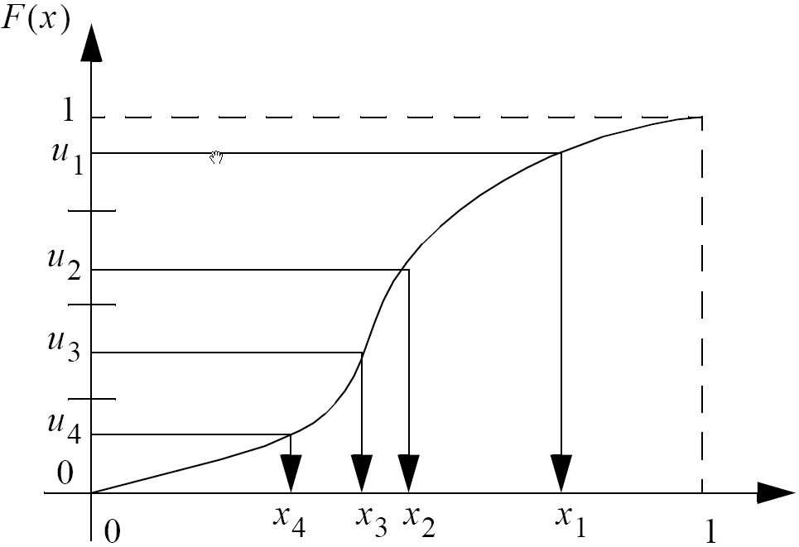
Combination of stratified sampling and the transformation method
Transformation through
the inverse cdf
Stratification in the space
of random numbers

Slide 38
Quasi-Monte Carlo methods (QMC)
Use of strictly deterministic sequences instead of (pseudo-)random numbers
Pseudo-random numbers replaced by low-discrepancy sequences
Everything works as in regular MC, but the underlying math is different (nothing is random so the math cannot be built on probability theory)

Slide 39
Discrepancy
High Discrepancy
(clusters of points)
Low Discrepancy
(more uniform)

Slide 40
Stratified sampling
Henrik Wann Jensen
10 paths per pixel

Slide 41
Quasi-Monte Carlo
Henrik Wann Jensen
10 paths per pixel

Slide 42
Same random sequence for all pixels
Henrik Wann Jensen
10 paths per pixel

Slide 43
Image-based lighting

Slide 44
Image-based lighting
Introduced by Paul Debevec (Siggraph 98)
Routinely used for special effects in films & games

Slide 45
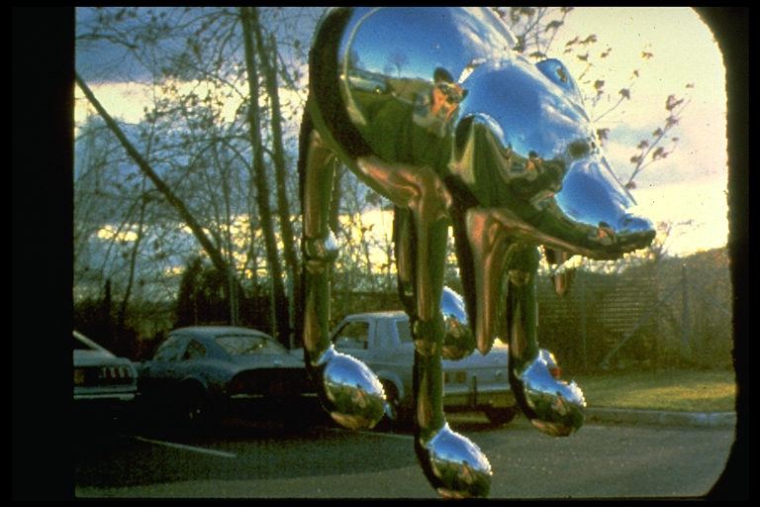
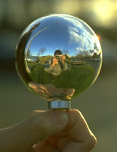
Environment mapping (a.k.a. image-based lighting, reflection mapping)
Miller and Hoffman, 1984
Later, Greene 86, Cabral et al, Debevec 97, …

Slide 46
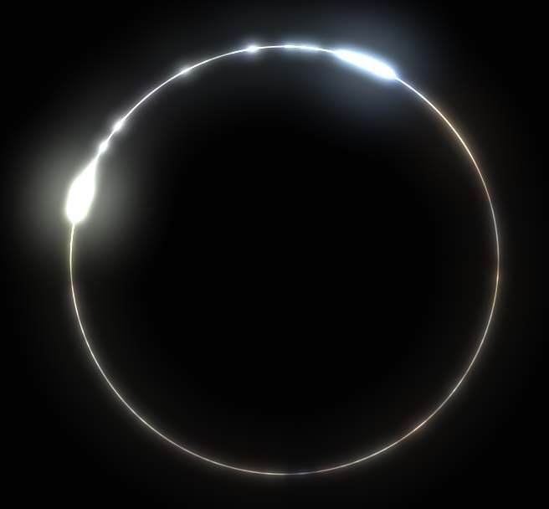
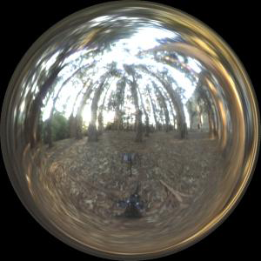
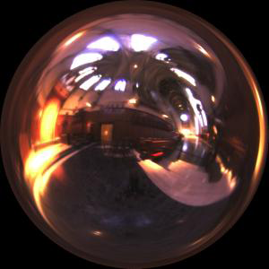
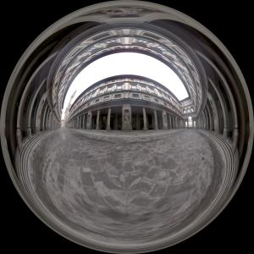
Image-based lighting
Illuminating CG objects using measurements of real light (=light probes)
Light
Eucaliptus
grove
Grace
cathedral
Object
Uffizi
gallery
© Paul Debevec

Slide 47
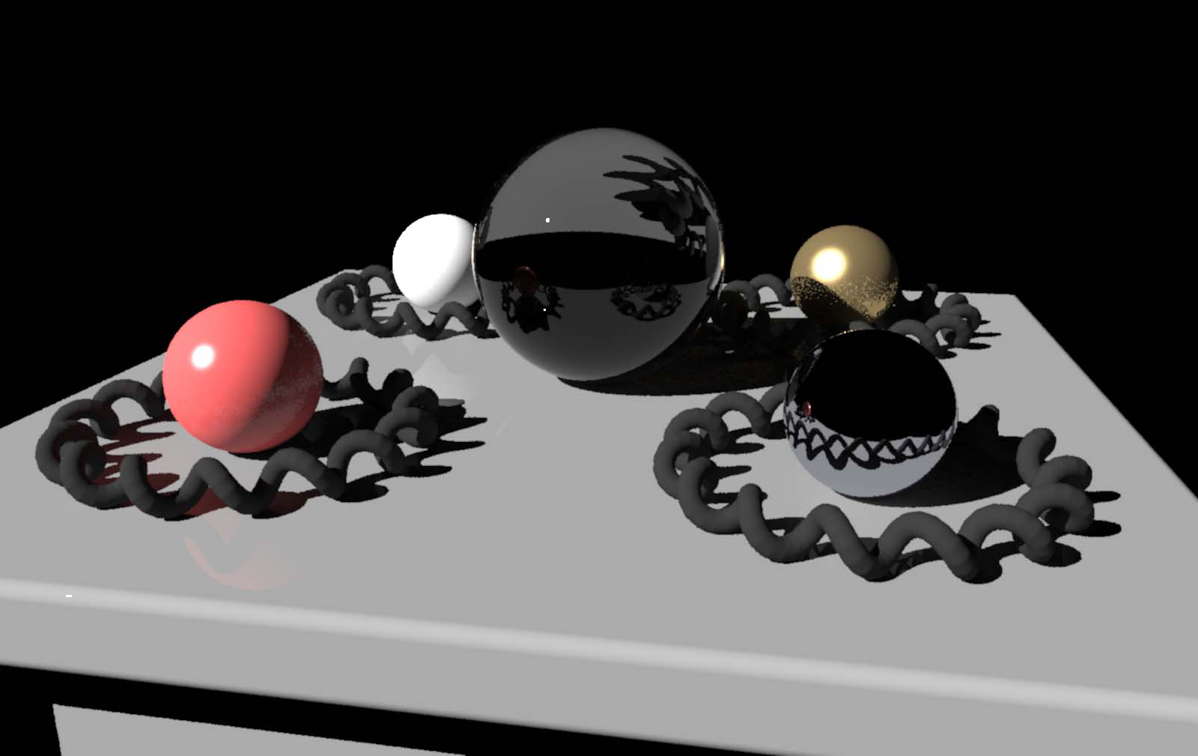
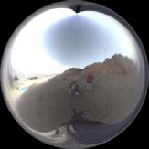
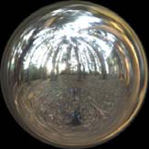
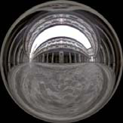

Point Light Source
Point lighting
© Paul
Debevec

Slide 48
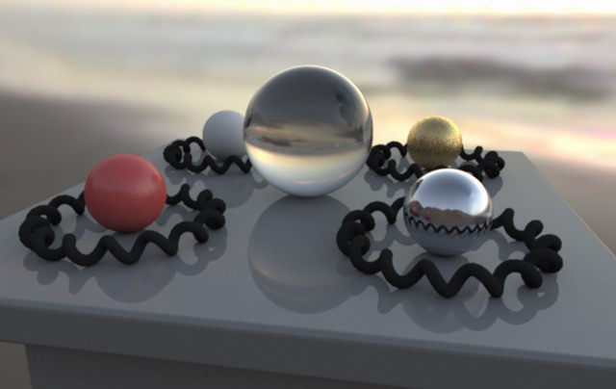
Image-based lighting
© Paul
Debevec

Slide 49
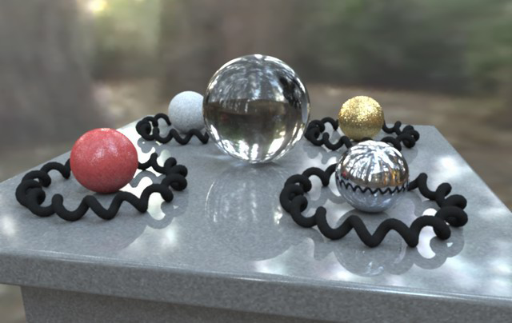
Image-based lighting
© Paul
Debevec

Slide 50
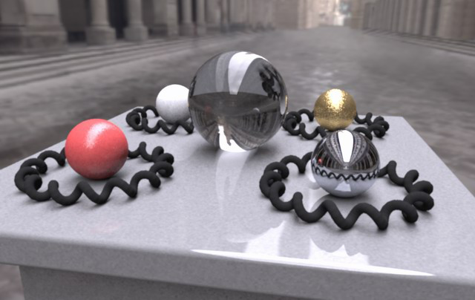
Image-based lighting
© Paul
Debevec

Slide 51
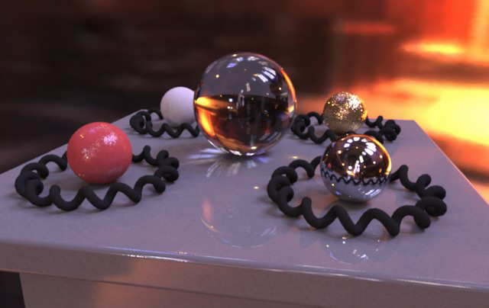
Image-based lighting
© Paul
Debevec

Slide 52
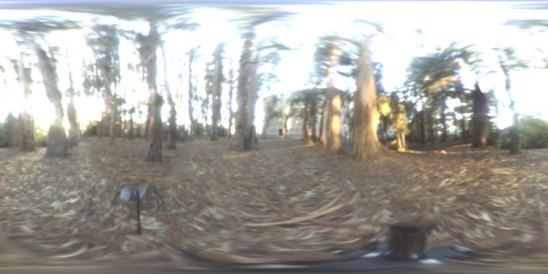
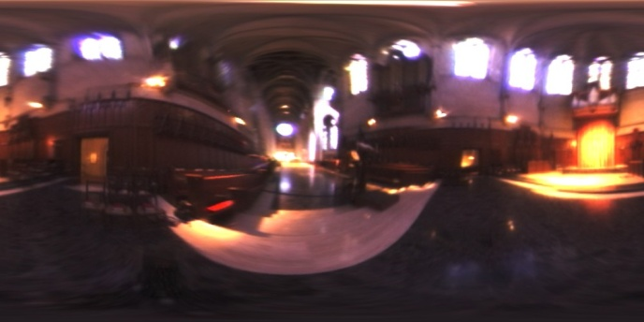
Mapping
Eucaliptus grove
Grace cathedral
Debevec’s spherical
“Latitude – longitude” (spherical coordinates)
Cube map

Slide 53
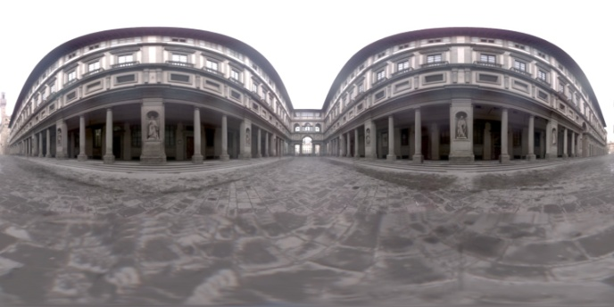
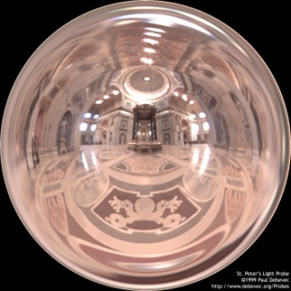
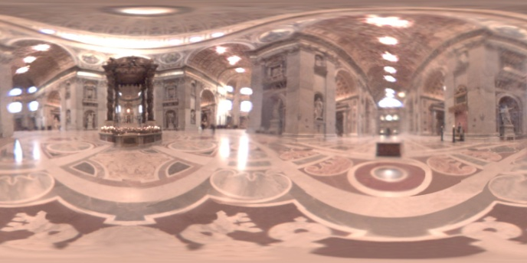
Mapping
Uffizi gallery
St. Peter’s Cathedral
Debevec’s spherical
“Latitude – longitude” (spherical coordinates)
Cube map

Slide 54

Debevec’s spherical mapping
Mapping from direction in Cartesian
coordinates to image UV.
float d = sqrt(dir.x*dir.x + dir.y*dir.y);
float r = d>0 ? 0.159154943*acos(dir.z)/d : 0.0;
u = 0.5 + dir.x * r;
v = 0.5 + dir.y * r;
Quote from “http://ict.debevec.org/~debevec/Probes/”
The following light probe images were created by taking two pictures of a mirrored ball at ninety degrees of separation and assembling the two radiance maps into this registered dataset. The coordinate mapping of these images is such that the center of the image is straight forward, the circumference of the image is straight backwards, and the horizontal line through the center linearly maps azimuthal angle to pixel coordinate.
Thus, if we consider the images to be normalized to have coordinates u=[-1,1], v=[-1,1], we have theta=atan2(v,u), phi=pi*sqrt(u*u+v*v). The unit vector pointing in the corresponding direction is obtained by rotating (0,0,-1) by phi degrees around the y (up) axis and then theta degrees around the -z (forward) axis. If for a direction vector in the world (Dx, Dy, Dz), the corresponding (u,v) coordinate in the light probe image is (Dx*r,Dy*r) where r=(1/pi)*acos(Dz)/sqrt(Dx^2 + Dy^2).

Slide 55
Sampling strategies for image based lighting
Technique (pdf) 1:
BRDF importance sampling
    Generate directions with a pdf proportional to the BRDF
Technique (pdf) 2:
Environment map importance sampling
  Generate directions with a pdf proportional to L(ω) represented by the EM

Slide 56
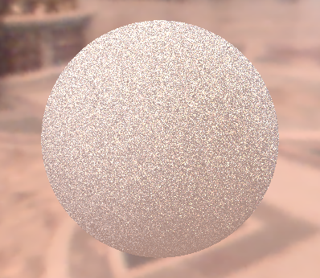
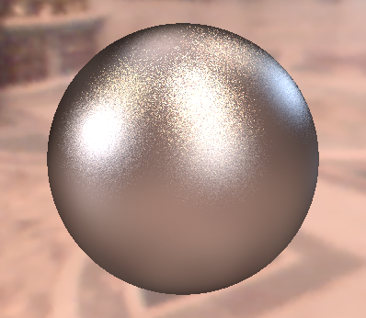
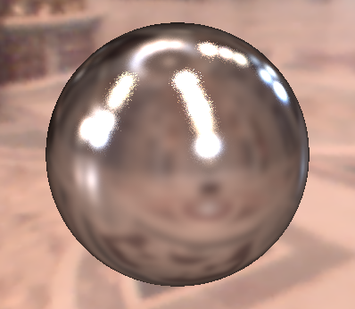
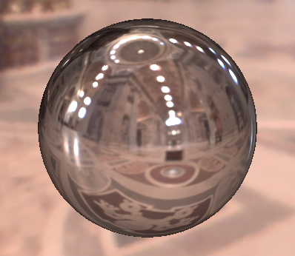
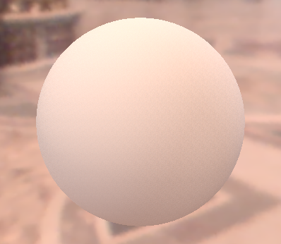
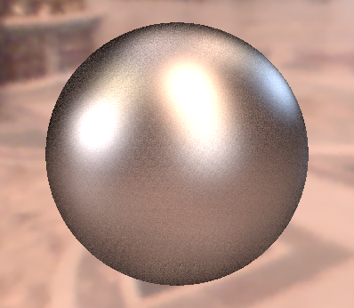
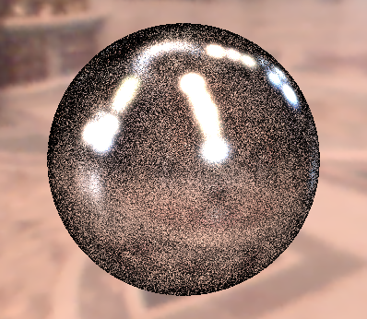
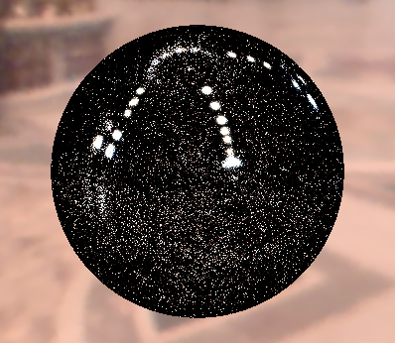




Sampling strategies
BRDF IS
600 samples
EM IS
600 samples
MIS
300 + 300 samples
Diffuse only
Ward BRDF, α=0.2
Ward BRDF, α=0.05
Ward BRDF, α=0.01

Slide 57
Sampling according to the environment map luminance
Luminance of the environment map defines the sampling pdf on the unit sphere
For details, see PBRT

